Slide 1
West Texas A&M University
A Guide for Students and Student Organizations
www.wtamu.edu/orgs

Slide 2
What is Risk Management?
Risk Management is the process of considering the potential and perceived risk involved in student activities.
It includes monitoring organization activities and taking both corrective action and proactive steps to minimize accidental injury and/or loss.
Each organization is required to sign the risk management form after reporting the program content to your organization
Notes:
2

Slide 3
High Risk Activities
Hazing
Alcohol and Illegal Drugs
Behavior at Parties and Social Events
Sexual Violence and Harassment
Clery Act
Fire and Other Safety Issues
Travel
Notes:
3

Slide 4
Risk Management Concepts
Identify risky behavior and activities
Assess the probability of adverse outcomes
Implement controls to eliminate or reduce the risk
Reassess the activity after the risks have been managed (Source: Georgia Institute of Technology, 2002)
Notes:
4
Three major concepts associated with risk management:
Identify risky behavior – can injury or loss occur as a result of participation in or attendance at the event or activity (running with pointed scissors in your hand)
Assess the probability – how likely is an injury or loss to occur while performing the activity (running with scissors on a rocky hill)
Eliminate or reduce risk – you may not be able to completely eliminate all risks; however, what methods or controls can be implemented to make the event safer (controlling the use of alcohol, not allow running with sharp pointed items, etc.)
Reassess the activity – now that the obvious risks have been addressed, what else can be done to minimize the risks

Slide 5
When considering risk concerns for your organizations remember your resources on campus: *Student Engagement & Leadership Office, UPD, and the Risk Management Office
Notes:
5

Slide 6
Find strategies you can apply to reduce the severity of the risk and probability that something will go wrong…
www.wtamu.edu/risk
Notes:
6

Slide 7
RISK MANAGEMENT AND INSURANCE MATRIX
Please feel free to speak to or consult with staff in Student Activities to assist in this risk assessment and insurance management process.
Step One – List all event activities or concerns.
Step Two – Identify risks associated with each activity.
Step Three – Use the Matrix to determine the level of risk before applying any Risk Management strategies
Step Four – Brainstorm methods to manage risks. See if you can reduce the probability that something will go wrong.
Step Five – Submit Risk Management & Insurance Matrix with Activity Proposal to Student Activities.
NAME OF EVENT: WTAMU Outdoors
LIST SPECIAL ACTIVITIES | ASSOCIATED RISKS* | SERIOUSNESS | PROBABILITY | METHOD TO MANAGE RISKS**
BB Gun Shooting Climbing Wall Archery ATV’s | 1. 2. 3. 4. | 1. 2. 3. 4. | 1. 2. 3. 4. | 1. 2. 3. 4.
* Possible risks include: medical emergencies, food poisoning/allergic reactions, damage to University reputation, damage to University property and/or facilities, accidents, injury, and/or death.
**Methods to manage risks may include: purchasing special event liability insurance, arranging for security through UPD, traveling with an advisor, rotating drivers, etc.
SERIOUSNESS
I – May result in death.
II – May cause severe injury, major property damage, significant financial loss, and/or result in negative publicity for the organization and/or institution.
III – May cause minor injury, illness, property damage, financial loss, and/or could result in negative publicity for the organization and/or institution.
IV – Hazard presents a minimal threat to safety, health, and well-being of participants.
 | Probability
Seriousness | A | B | C | D
I
II
III
IV
PROBABILITY
A – Likely to occur immediately or in a short period of time, expected to occur frequently.
B – Probably will come in time
C – May occur in time.
D – Unlikely to occur.
If any special activity score is within the red or yellow the Office of Student Activities must review. The Risk Management & Insurance Matrix must be filed when an Activity Proposal is require.
The form has been provided as an educational tool to help student leaders to develop a process for identifying and discussing potential risk issues. It is intended for use as part of a larger event planning process, and should only serve as a starting point for your discussion on risk management. It is not designed to take the place of a careful review of applicable rules, policies, and laws, or discussion with your advisor. Completion of this form does not imply approval or authorization of your event. For more information on event planning, contact the CORE office.

Slide 8
Decide on an acceptable level of risk for your organization:
Consider modifying activities that have unreasonable risk associated with your organization.
Remember to consider how the activities relate to the mission and purpose or your organization.
Notes:
8
Questions to think about:
How will this activity benefit your organization? How does it benefit our university?
Are there ways that you can still engage in this activity and reduce the risk associated with it?

Slide 9
What is Hazing?
Hazing is a broad term encompassing any action or activity which does not contribute to the positive development of a person; which inflicts or intends to cause physical or mental harm
It is defined in the Texas Education Code (Subchapter F. Sec. 37.151)
and the West Texas A&M Code of Student Life.

Slide 10
Hazing Defined.
Intentional, knowing, or reckless act directed against a student by one person acting alone or by
more than one person occurring on or off University premises that endangers the mental or physical health or safety of a student
for the purpose of pledging or associating with, being initiated into, affiliating with, holding
office in, seeking and/or maintaining membership in any organization or program whose membership
consists of students. Consent and/or acquiescence by a student or students subjected to hazing is
not a reasonable defense in a disciplinary proceeding. Hazing includes, but is not limited to:
a. Any type of physical brutality, such as whipping, beating, using a harmful substance on the
body or similar activity.
b. Any type of physical activity that subjects the student to an unreasonable risk of harm or
that adversely affects the mental or physical health or safety of a student, such as sleep
deprivation, exposure to the elements, confinement in a small space, or calisthenics.
c. Any activity involving consumption of a food, liquid, alcoholic beverage, liquor, drug or
other substance which subjects a student to an unreasonable risk of harm or which adversely affects
the mental or physical health or safety of a student.
d. Any activity that intimidates or threatens a student with ostracism, subjects a student to
extreme mental stress, shame or humiliation, adversely affects the mental health or dignity of a
student, or discourages a student from entering or remaining enrolled at the University, or may
reasonably be expected to cause a student to leave the organization or the University rather than
submit to acts described above.
e. Any activity in which a person solicits, encourages, directs, aids or attempts to aid another
in engaging in hazing; intentionally, knowingly or recklessly permits hazing to occur; has
firsthand knowledge of the planning of a specific hazing incident which has occurred and knowingly
fails to report the incident in writing to the Office of Student Conduct.
f. Any activity in which hazing is either condoned or encouraged or any action by an officer or
combination of members, pledges,
associates or alumni of the organization of committing or assisting in the commission of hazing.

Slide 11
Examples of Hazing
If you’re not sure whether or not something happening to you or to someone else is hazing, ask yourself these questions:
Would I feel comfortable participating in this activity if my parents were watching?
Would we get in trouble if a school/college administrator walked by and saw us?
Am I being asked to keep these activities a secret?
Am I doing anything illegal?
Does participation in this activity violate my values or those of this organization?
Is this causing emotional or physical distress or stress to myself or to others?
Am I going to be able to get a job if I have to put a criminal arrest on my application?
Don’t Be Confused:
If you have to ask if it’s hazing, then it probably is!

Slide 12
Examples of Hazing
Signatures
Physical Harm
Calisthenics
Forced Labor
Kidnapping
Errands for active members
Introductions
Forced Physical Activity
Sleep Deprivation
Required alcohol purchase/and or consumption
Don’t Be Confused:
If you have to ask if it’s hazing, then it probably is!

Slide 13
Why Does Hazing Happen?
We are raised in a culture of hazing
Some forms are personally acceptable
New members expect to be hazed
Advisors may say don’t get caught hazing

Slide 14
Who Is Responsible for Stopping Hazing?
You are!
If you witness a hazing incident or if you are hazed, you are responsible for making sure you report the incident to the proper authorities.
It is your responsibility to report and prevent hazing. If you observe hazing and stand by silently, your silence condones these illegal activities and makes you just as liable as the offenders.

Slide 15
Behavior Intervention Team
Caring and Prevention

Slide 16
Mission of the BIT
The overall mission of BIT is to
review behavioral incidents and ensure a systematic response to students whose behavior may be disruptive/harmful to themselves and/or the WTAMU community
support student success and
assist in protecting the health, safety and welfare of the students and members of the WTAMU community.

Slide 17
Goals of the BIT
Preventing crises
Outreach
Consultation
Referrals
Follow-up processes
Access to appropriate services
Data collection and sharing
Centralizing information to observe behavior patterns
Providing documented response to distressed students

Slide 18
Tasks of the BIT
Review behavior situations where a potential risk of harm to self and/or others exists
Consult with administration/faculty/staff
Coordinate non-emergency response to violent, threatening, distressed students
Develop specific strategies to address behavior
Make recommendations for future action

Slide 19
The Team
Academic Affairs – Dr. Amy Anderson
Student Affairs – Mike Knox, Dr. Christina Cox-Leisinger
Student Counseling Services – Orvie Nix
University Police Department - Chief Shawn Burns
Residential Living – Cindy Spencer
Academic Advising – Rebekah Bachman
Health Integration Specialist – Dayna Schertler
Student Disability Services – Paul Fenstermaker

Slide 20
How to Make a BIT Referral:
Visit the BITeam website and submit
referral on-line
wtamu.edu/BITeam

Slide 21
Alcohol, Illegal Drugs, and Penalties: (also refer to Code of Student Life and the Campus Security Report- available online at www.wtamu.edu)

Slide 22
Alcohol, Illegal Drugs and Penalties
Public intoxication – Occurs to the degree that a person may endanger himself/herself or others due to mental and physical impairment.
An officer is not required to give you a breath test or a field sobriety test to show that you are publicly intoxicated.
Minor in Possession - MIP - A person under 21 in possession of an alcoholic beverage is in violation.
Minor in Consumption – MIC – could involve just taking one sip of alcohol to violate the law.
Fine starting at $250.00
Plus suspension of Drivers license
Notes:
Minor is Possession
A person can also receive a citation for minor in possession even if they just have constructive possession such as sitting next to it when the police arrive.
Minor in Consumption
All an officer has to do is smell the alcohol on your body or breath.

Slide 23
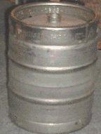
Alcohol, Illegal Drugs and Penalties
It’s illegal to use someone else’s identification or a fake ID, especially to buy alcohol. You can be arrested and taken to jail for this offense!
Purchase / Furnish Alcohol to a Minor
Fines:
Up to $4,000.00
and Up to 1 yr. in Jail
Furnishing alcohol to a minor or providing a place for a minor to consume alcohol is a serious Class A misdemeanor and is under the jurisdiction of the County Court. A Class A misdemeanor is one step below a felony.
Remember if you are having a party at your house
or apartment, you are responsible. If one minor is
found drinking at your party you are in violation.
Notes:
Most people don’t know that a person who is a minor can also be charged with this crime.

Slide 24
Alcohol, Illegal Drugs and Penalties
Driving Under the Influence - Minor
A minor is DUI when having any detectable amount of alcohol while operating a motor vehicle.
The 1st offense is a Class C misdemeanor
Fines: Confinement in jail for up to 180 days, a fine up to $500 and driver’s license suspension 90 days to 1 year, 20-40 hours of community service
Driving While Intoxicated
A person is Driving While Intoxicated when having a blood alcohol concentration of 0.08 or more while operating a motor vehicle.
The 1st offense is a Class B misdemeanor
Fines: Confinement in jail for up to 180 days, a fine up to $2,000 and driver’s license suspension 90 days to 1 year
The 2nd offense is a Class A misdemeanor
Fines: Confinement in jail a minimum of 30 days & up to one year, a fine not to exceed $4,000 and driver’s license suspension 180 days to 2 years
The 3rd offense is a third degree felony
Fines: 2 to 10 years in prison, a fine not to exceed $10,000, an driver’s license suspension 180 days to 2 years
(Fines do not include court cost and lawyer fees)
Notes:
Driving Under the Influence
Not to be confused with Driving While Intoxicated. The police only have to show that a minor has a detectible amount of alcohol in their system. One beer could be considered a detectible amount.

Slide 25
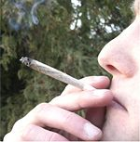
Alcohol, Illegal Drugs and Penalties
Possession of Drugs
The possession of a usable quantity of Marijuana (2 oz. or less), Synthetics (K-2, Spice, bath salts), THC oils and edibles is an offense under state law.
This offense is a Class B Misdemeanor
Fine: Confinement in jail for up to 180 days
and a fine up to $2,000
Heroin, Cocaine, Methamphetamine, Methadone, Opiates, etc.
Possession of any of these drugs can carry a range of felony punishments.
Notes:
A major enhancement for possession of a narcotic or marijuana is possession near or at a school. These enhancements raise the punishment level one full degree so if you have enough for a misdemeanor of campus it could be enough for a felony on campus that would carry prison time.
Some drugs such as LSD WILL remain in your system forever, and many drugs cause a lasting addiction after the first use that a person would have to fight for the rest of their lives.

Slide 26
Alcohol, Illegal Drugs and Penalties
Methods of Control
Check IDs and use bracelets to identify those over 21.
Serve non-alcoholic beverages.
Limit the start and end times. For example, limit parties to four hours.
Maintain control of all alcoholic beverages present.
Do not allow impaired individuals to drive.
Seek medical assistance as needed and do not leave the person alone.
Notes:
It only takes one minor drinking to undo all your preparations.

Slide 27
Behavior at Parties and
Social Events
*Remember that there are alternative forms of transportation available if you’ve had too much to drink…
Call a cab or call a friend

Slide 28
Behavior at Parties
Can Our Organization Be Held Responsible for an Individual’s Behavior?
YES!
It can depend on number of members attending BUT most importantly…
You assume responsibility if the activity is related to the organization.
Organizations may be held responsible when…
acts of individual members are directly related to the student organization's activities.
a member is violating local, state, or federal law or University regulations and other members fail to discourage the activity.
Remember … in addition to the group being held responsible, members, officers, and even advisors may be held individually responsible for an individual members actions.
Notes:
Yes!
The degree to which an organization is responsible for the behavior of its members is not necessarily dependent upon the number of members engaging in the activity, but depends upon whether the activity is related to the organization.

Slide 29
Burglary Property Awareness (Did you know...)?
Your vehicle or dorm room could be burglarized in less time than it takes to read this slide…
Most commonly stolen items include:
- Wallets, purses, backpacks
- Cell phones
- Radar detectors
- Portable electronics
- Small personal items
Lock your door, even if you are only going to the bathroom or leaving momentarily. Lock your vehicles and roll up windows!
If your wallet/purse is stolen, you could become a victim again, this time of fraud and identity theft.
It takes time to straighten out problems with creditors and your credit may be damaged (remember to alert the 3 major credit bureaus).
If you happen to walk up on your vehicle while a crime is in progress, report it and avoid a violent confrontation (Your life is not negotiable for property!)

Slide 30
In Case of Campus Emergency:
Broadcast e-mails
Local Media Contacts
Building & Floor Coordinators
Enroll in the WT Emergency Notification System called Buff-Alert, which will e-mail and text your designated phone number in case of a campus emergency.
**You can also Text crime tips to 79516**

Slide 31
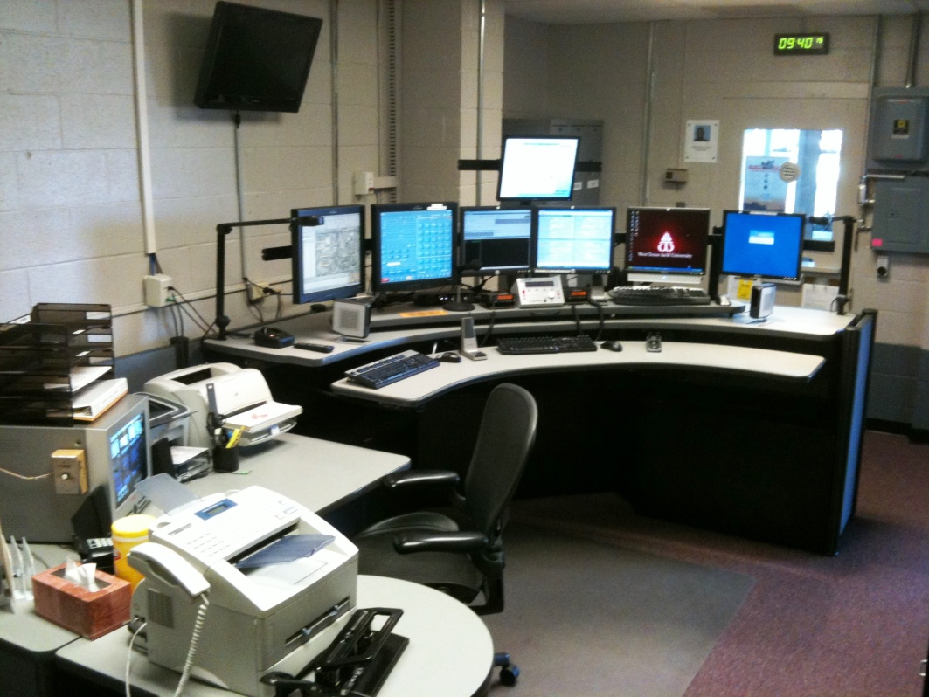
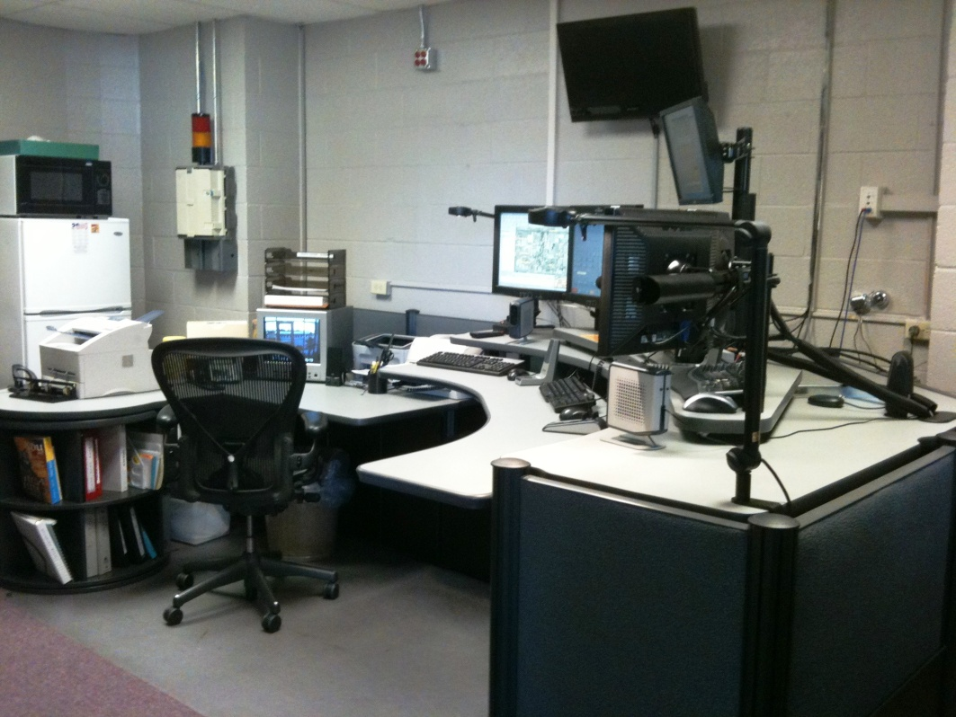
PSAP (#911)-Public Safety Answering Point
IMPORTANT INFORMATION ABOUT 911 CALLS :
The UPD Communications Center allows the general public access to a "real" person 24 hours per day. Telecommunicators are trained to handle emergency calls and utilize the computerized dispatch center. The Communications Center’s computerized systems allow telecommunicators to communicate with other police agencies all over the nation and in 150 foreign countries through access of the Texas Law Enforcement Telecommunications System, National Crime Information Computer and Texas Crime Information Computer. To reach the telecommunications center, call (806) 651-2300.

Slide 32
With regard to campus safety:
“If you see something, say something…”

Slide 33
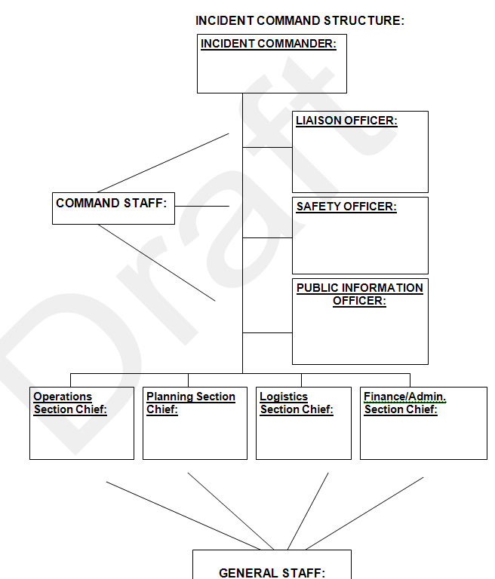
Emergency Operations Plan
Available at wtamu.edu

Slide 34
Sexual Violence Sexual Harassment

Slide 35
Sexual Violence-Sexual Harassment
Sexual Violence – physical sexual acts perpetrated against a person’s will or when a person is incapable of giving consent. A number of different acts falls into the category of sexual violence, including sexual assault, sexual battery, sexual abuse, sexual coercion, and sexual exploitation.
Sexual Harassment is a form of sex discrimination. Unwelcome sexual advances, requests for sexual favors and other verbal, nonverbal or physical conduct of a sexual nature constitute sexual harassment when this conduct is so severe, persistent or pervasive that it explicitly or implicitly affects an individual's employment, unreasonably interferes with an individual's work or educational performance, or creates an intimidating or hostile work or educational environment. Unwelcome means that an individual did not request or invite it and considers the conduct to be undesirable or offensive. Submission to the conduct or failure to complain does not always mean that the conduct was welcome. Sexual harassment may be quid pro quo (“this for that”) or may constitute a hostile environment. Sexual harassment includes non - consensual sexual contact, sexual assault, sexual exploitation, and stalking, dating violence, and domestic violence when based on sex. Federal law prohibits sexual harassment of college students whether the harasser is an employee, another student or a third party.

Slide 36
Reporting Sexual Violence and Harassment
West Texas A&M University provides equal opportunity to all employees, students, applicants for employment, and the public regardless of race, color, religion, sex, national origin, disability, age, genetic information or veteran status. West Texas A&M University will promptly and thoroughly investigate all complaints of discrimination, sexual harassment, and related retaliation in accordance with applicable federal and state laws, Texas A&M University System Policy 08.01 and Regulation 08.01.01, and university rules and/or procedures.
Any member of the campus community or public who witness, are subjected to, or are informed about incidents of discrimination, sexual harassment, and/or related retaliation involving faculty, staff, or students should contact Becky Lopez, 2501 4th Avenue, Canyon, Texas, (806) 651-3199.

Slide 37
Sexual Violence-Sexual Harassment
If you have been Sexually Assaulted
Find a safe environment
Preserve the evidence of attack
Report the attack as soon as possible
Seek medical attention
Find out about your resources:
Contact WT’s Victim’s Assistance Coordinator at #651-2307
Helping Victims
Let victims make decisions
Listen with patience
Active Listening
Provide victims with information and referrals

Slide 38
Sexual Violence-Sexual Harassment
How to Reduce the Risk of Sexual Assault
Educate Yourself
Look out for friends
Stay in Groups
Never be alone with someone you don’t know
Decide what your limits are and communicate them clearly
Do not assume anything
TRUST YOUR INSTINCTS
Never leave drinks unattended

Slide 39
Watch Your Drink!!!
Keep an eye on your friends’ drinks
Date rape drugs can happen
If you think you’ve consumed a drink containing a date rape drug:
- Call 911
- Get to a hospital quickly

Slide 40
The Clery Act

Slide 41
In 1986 she was sexually assaulted, strangled, murdered
Perpetrator was a student that entered the hall with the intent to burglarize rooms
181 situations of auto-locking doors being propped open reported from her Hall
38 violent crimes reported on the Lehigh campus in prior three years, not reported to the community
Resident hall room left unlocked for roommate
Congress enacted the Clery Act in 1990
Jeanne Clery 19 year old Freshman Lehigh University She was a good student, well-liked, athletic, and had an infectious laugh.
Why we have the Clery Act:

Slide 42
Clery Act Federal Mandated Responsibilities
Educate students in primary prevention, ongoing prevention and awareness of sexual assault, stalking, dating and domestic violence
Be an active bystander
Know how to reduce your risk
Review Campus Security and Fire Safety Report www.wtamu.edu/reports
Report crime associated with your organization for review to be included in annual security report

Slide 43
Campus Security Authority Function
Criminal Offenses to Report
A CSA is to report to the official or office designated by the institution to collect crime report information, such as the campus police, those allegations of Clery Act crimes that he or she concludes were made in good faith
Murder/Non-negligent Manslaughter
Negligent Manslaughter
Sex Assault
Rape
Fondling
Incest
Statutory Rape
Robbery
Aggravated Assault
Burglary
Motor Vehicle Theft
Arson
Stalking
Dating Violence
Domestic Violence

Slide 44
Meri Lyn Odell Clery Coordinator modell@wtamu.edu 806-651-2307
Contact for additional training and information and to report crime (non-emergency) associated with your organization or during travel with your organization.

Slide 45
Fire and Life Safety

Slide 46
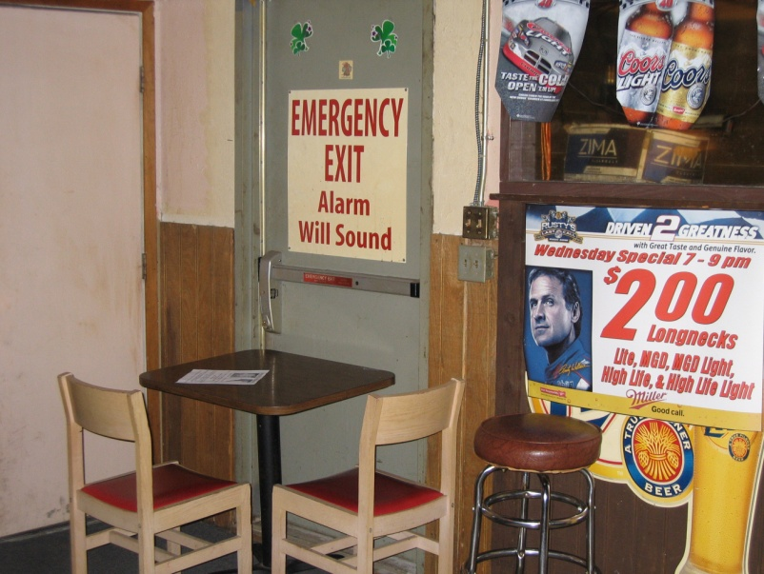
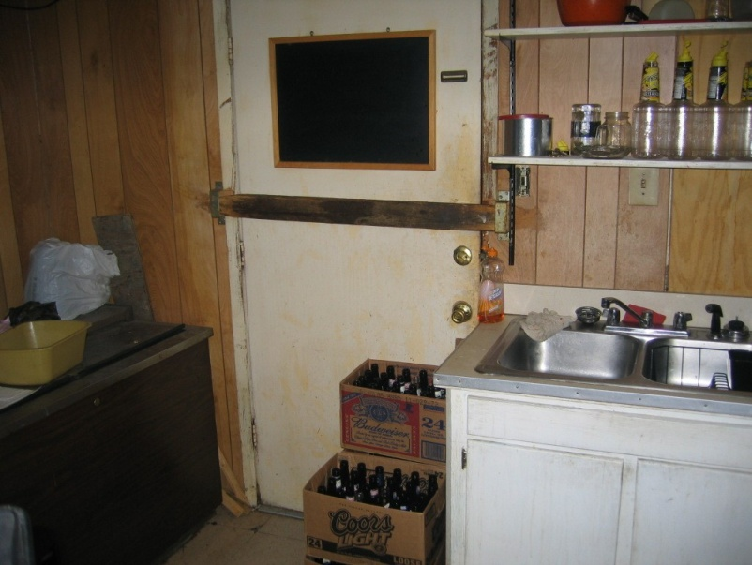
In case of fire, the best way out may not be the way in…
In a fire, seconds count. It is difficult to see through the thick, toxic smoke. People panic and rush to the only way they know out—the entrance. The entrance may not be the best (or quickest) way out, however.
When you enter a building, any building, plan an exit strategy. Notice at least two exits you could use in the event of a fire. Get out alive…. www.haveanexitstrategy.com

Slide 47
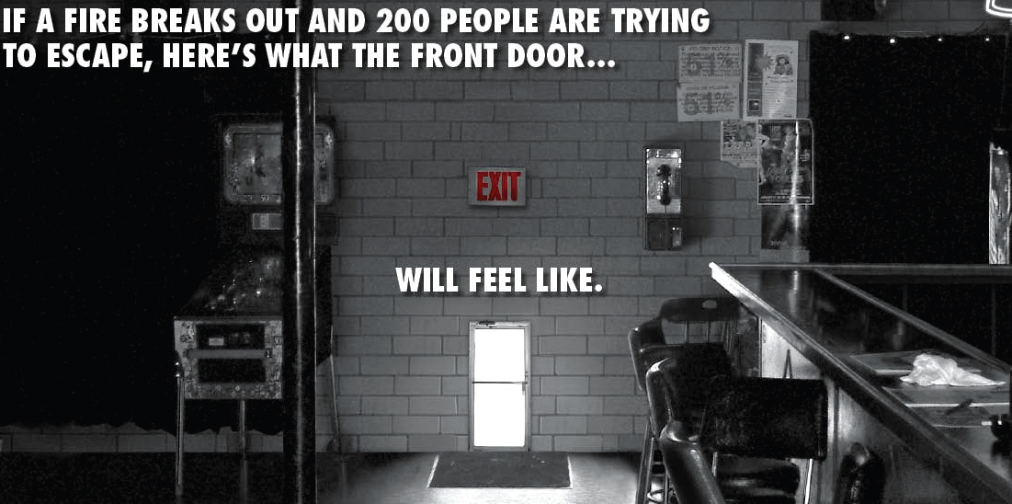
www.haveanexitstrategy.com

Slide 48
Fire and Life Safety
Events may have inherent physical risks that require contingency plans including:
Fire Safety – WT #651-2134
Inclement Weather – WT Weather Line #651-2010
Campus Emergency – University Police #911

Slide 49
Fire and Life Safety
General Fire/Life Safety Guidelines for Events:
First priority is to ensure safety of attendees
Have some method of accounting for attendees
Organizations should have Emergency contact numbers for Fire, Police, & Ambulance posted near common phones.
Prior to any event plan & provide for all facilities:
Evacuation routes
Shelter
Know specific location descriptions to direct emergency services.
The possession of firearms or explosive devices of any kind is forbidden.

Slide 50
Fire and Life Safety
Fire Safety
Fire – evacuate building and do not allow anyone to re-enter a building until cleared by the proper authority.
There are several common causes of accidental college fires:
Careless smoking
Unattended candles, incense, perfume burners
Cooking
Overloaded extension cords and power outlets
Leaves and debris located near buildings
Improper use of surge protectors
Unattended cooking grills

Slide 51
Food Safety:
The group hosting an event is responsible for all food safety preparation and service. Individuals within the group are expected to follow standard food safety and hygiene practices for food served or sold.
Safety Standards (including proper hand washing, hand sanitizer, and paper towels):
Monitor cooking thermometer temperatures:
Hot Dogs/Hamburgers 160˚F; Chicken 170˚F
Cold foods to be held at 41˚F
No cross contamination of cooked and uncooked foods
Sanitize all Utensils
Portable Fire Extinguishers for Barbecue Grilling
Disposable gloves for handled food

Slide 52
Travel
https://apps.wtamu.edu/student-travel/
www.wtamu.edu/orgs
https://wtaccess.wtamu.edu/travel/

Slide 53
Travel
General Requirements
If driving a University vehicle, you must be a WT employee and approved by providing your Driver’s License for a record check and you must attend a session of WT’s driver safety training.
Must have proof of personal automobile insurance and registration as required by state law, if personal vehicle to be used. (Plus Personal Vehicle Authorization Form)
Safe Driver Training available with Safety Office #806-651-2134.

Slide 54
Travel
General Requirements, cont.
All travel MUST be routed through the electronic system and if not, travel privileges will be revoked.
Additional training is available through the Office of Student Engagement & Leadership.

Slide 55
Travel
Things to Think About
Anticipate or prepare for bad weather and emergency expenses associated with travel
Preventable Risks (for example, transportation in open beds of trucks should be avoided)
Length of trip and number of available drivers

Slide 56
Risk Management Training
Next Steps
Within 45 days following completion training, the officers or advisors receiving the training must:
Report the program content at a meeting of the full membership of the recognized student organization.
Submit to the Office of Student Engagement and Leadership a signed statement saying the report was made.
Adopt a risk management policy for the organization.

Slide 57
Questions?
For all policies refer to:
The Campus Organizations Handbook and the Code of Student Life; both available at the Office of Student Affairs (JBK) or online at www.wtamu.edu

